Slide 1
Muhammad Danyal Rana
FA22-BCS-057
Notes:
This is my first slide of PowerPoint.

Slide 2
Lab-2 (Activty-8)
Games
WarCraft II
Diablo II
System Shock
Hardware
Software
Application Software
System Software
Notes:
This is my second slide of PowerPoint.

Slide 3

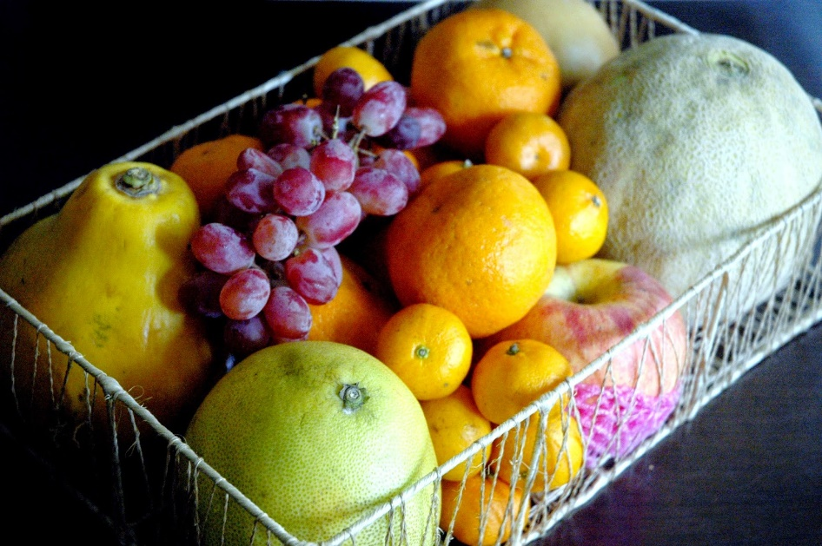
Inserting Images
Computer Scientist
Fruits

Slide 4
Hyperlink
In Slide #3, we have inserted the images.
If you want to know more about Computer Science, Click here.
If you want to know more about PowerPoint, Click here.
If you want to know about Hyperlinks, Click here.

Slide 5
Activity-15 (Photo Album)

Slide 6

Activity 16
IT Training
John Smith
Introduction
Different ways of learning
Training Materials
Training sessions
Training Topics

Slide 7
Activity 16
Training Topics
Microsoft Office Other Programs
Word Internet Explorer
Excel Windows
PowerPoint
Access
Outlook
Introduction
Different ways of learning
Training Materials
Training sessions
Training Topics
Training on Microsoft Office
Training Methods
Office
Software
Word
Excel
PowerPoint
Access

